Slide 1

SecureLifeCover
A dynamic and inclusive fintech company providing automated funeral cover payment solutions to underserved communities in South Africa.

Slide 2
The Problem
11 Million South Africans have a funeral policy
However, many forget to make payments, leading to lapsed policies and severe financial hardship during the bereavement process.
A major reason to that is people hold multiple policies and struggle to keep track of payments

Slide 3


The Current Landscape
Payment Method
Community Access
Debit Orders
Low
Cash Payments
Limited
*Financial Inclusion Tracker, World Bank (2021)

Slide 4




Our Solution: SecureLifeCover
Mobile-based Platform
Automated Payments
Mobile Wallet Integration
Secure Transactions
SecureLifeCover is a mobile application that enables users to manage their funeral cover payments conveniently on their smartphones.
The platform automates recurring payments to funeral parlors, ensuring that policies remain active and families are protected in the event of a loss.
SecureLifeCover integrates with popular mobile wallet providers, allowing users to seamlessly link their accounts and make payments directly from their wallets.
The platform utilizes the Interledger Protocol (ILP) to provide secure, transparent, and efficient financial transactions, ensuring the safety and reliability of funeral cover payments.

Slide 5
How it Works
Link mobile wallet to SecureLifeCover
Users securely connect their mobile wallets, such as MTN MoMo or Vodacom M-Pesa, to the SecureLifeCover app, enabling seamless integration for automated payments.
Set up automatic recurring payments
Users easily configure recurring payments to their preferred funeral parlors, ensuring their coverage remains active and their loved ones are protected.
Receive payment reminders
The SecureLifeCover app provides timely payment reminders, helping users stay on top of their funeral cover obligations and avoid lapsed policies.
Secure payments via Interledger Protocol (ILP)
All transactions are processed securely using the Interledger Protocol, a decentralized payment system that ensures transparent and reliable fund transfers.
Confirmation and peace of mind
Users receive confirmation of successful payments and can rest assured that their funeral cover is active, providing them and their families with financial protection during difficult times.

Slide 6
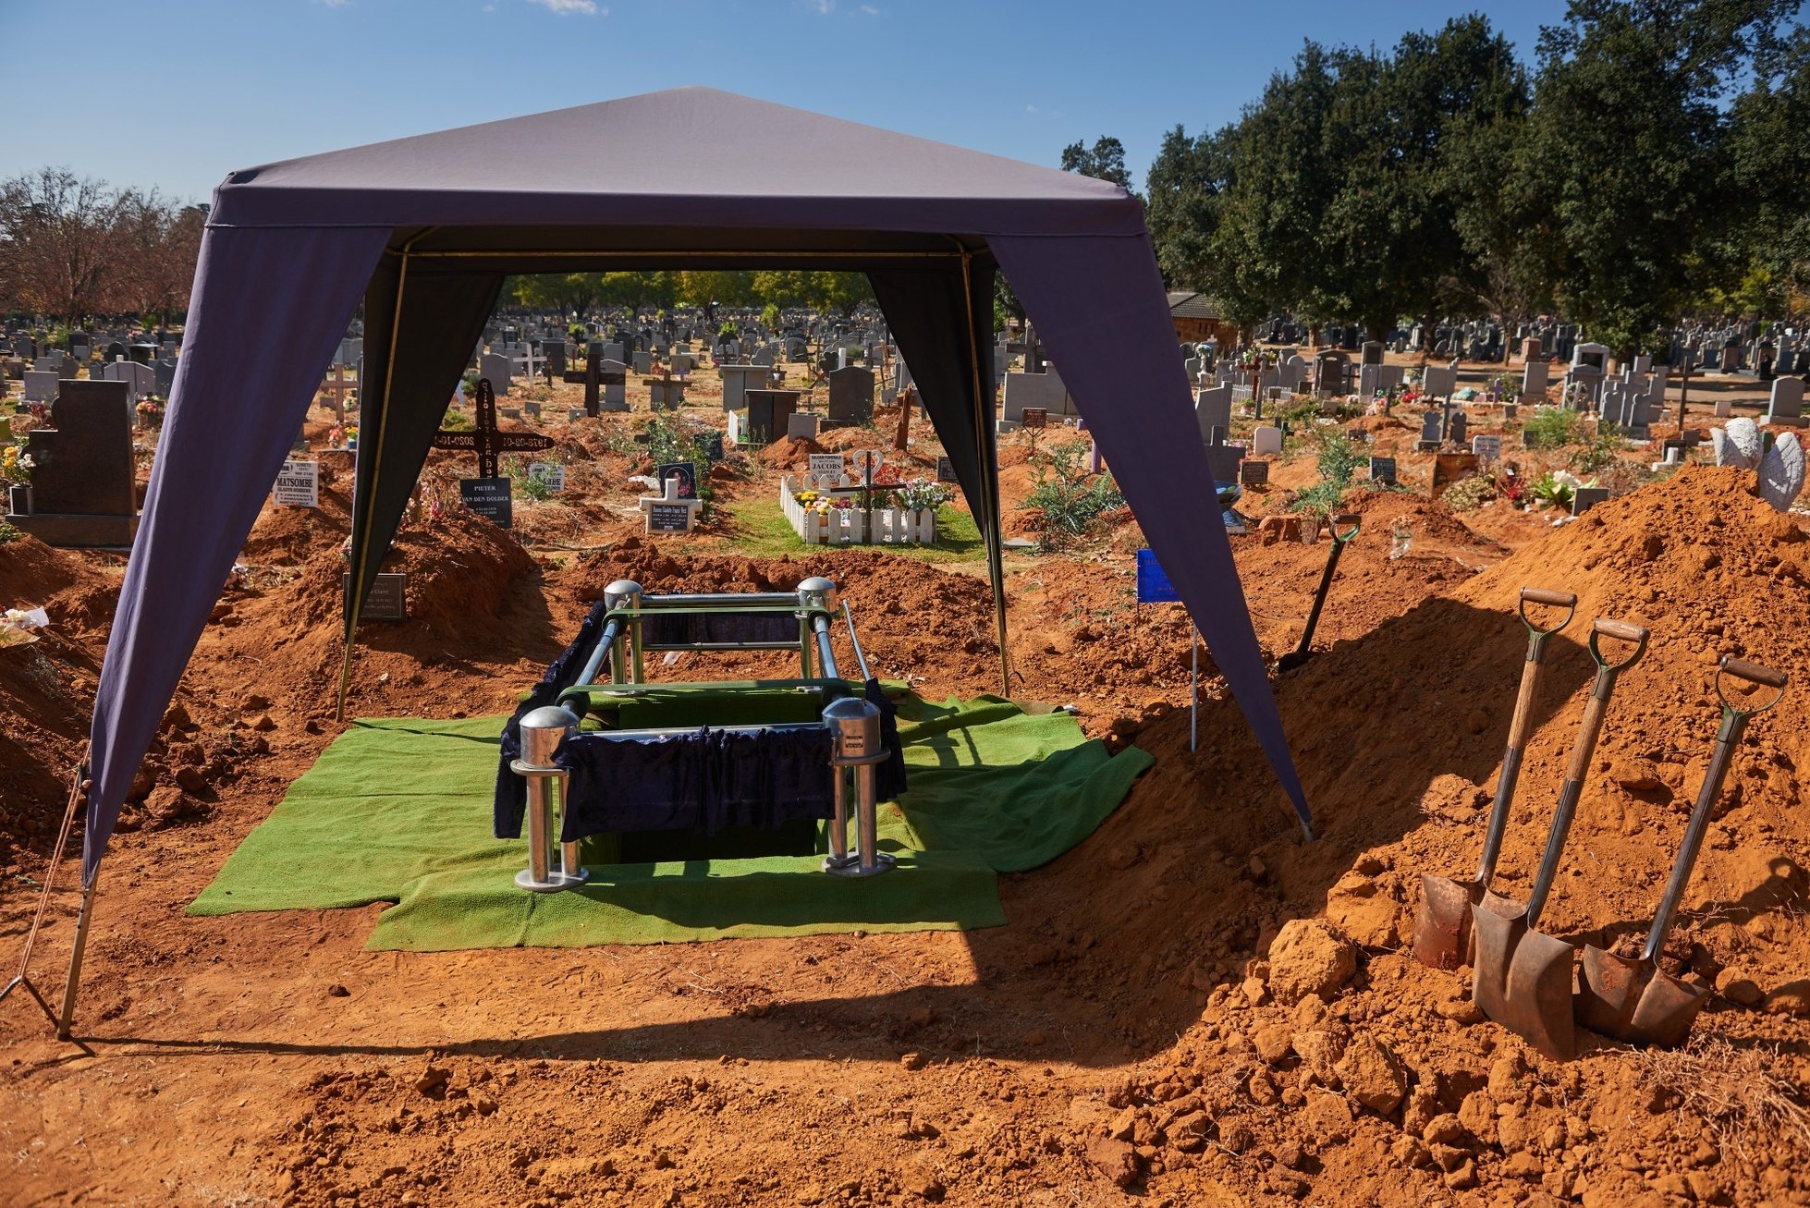
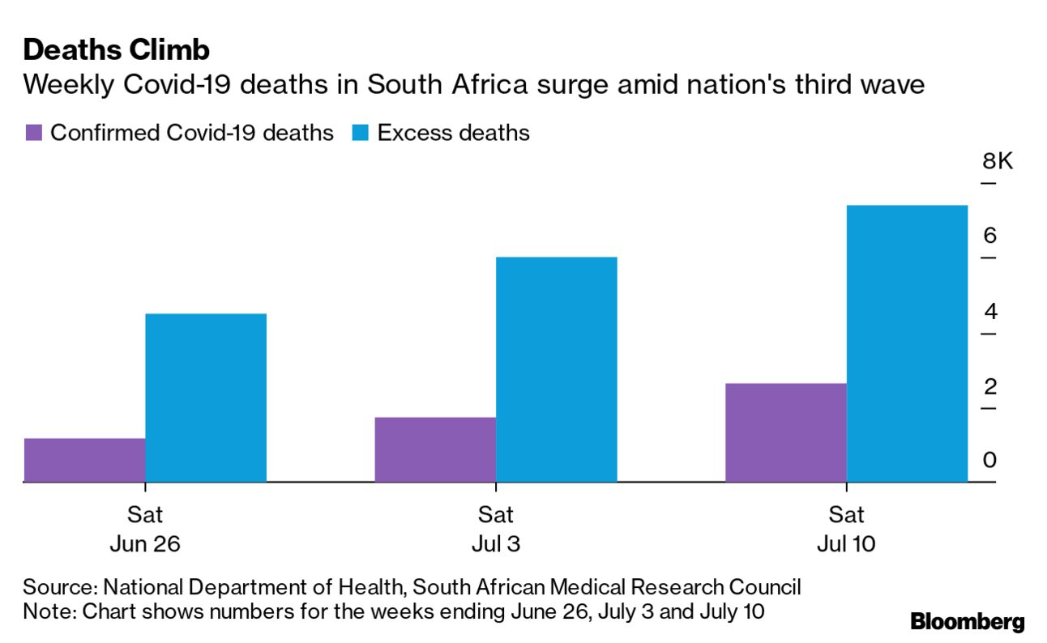


Market Opportunity
Underserved Communities
Growing Demand
Mobile Wallet Partnerships
Funeral Parlor Collaborations
Large segments of South Africa's population in rural and low-income urban areas lack access to formal funeral cover.
As the cost of living rises, there is an increasing need for affordable and accessible funeral cover solutions.
Partnering with popular mobile wallet providers could enable SecureLifeCover to reach a wider audience and leverage existing payment infrastructure.
Establishing partnerships with funeral parlors would allow SecureLifeCover to seamlessly integrate its automated payment platform into existing funeral services.

Slide 7
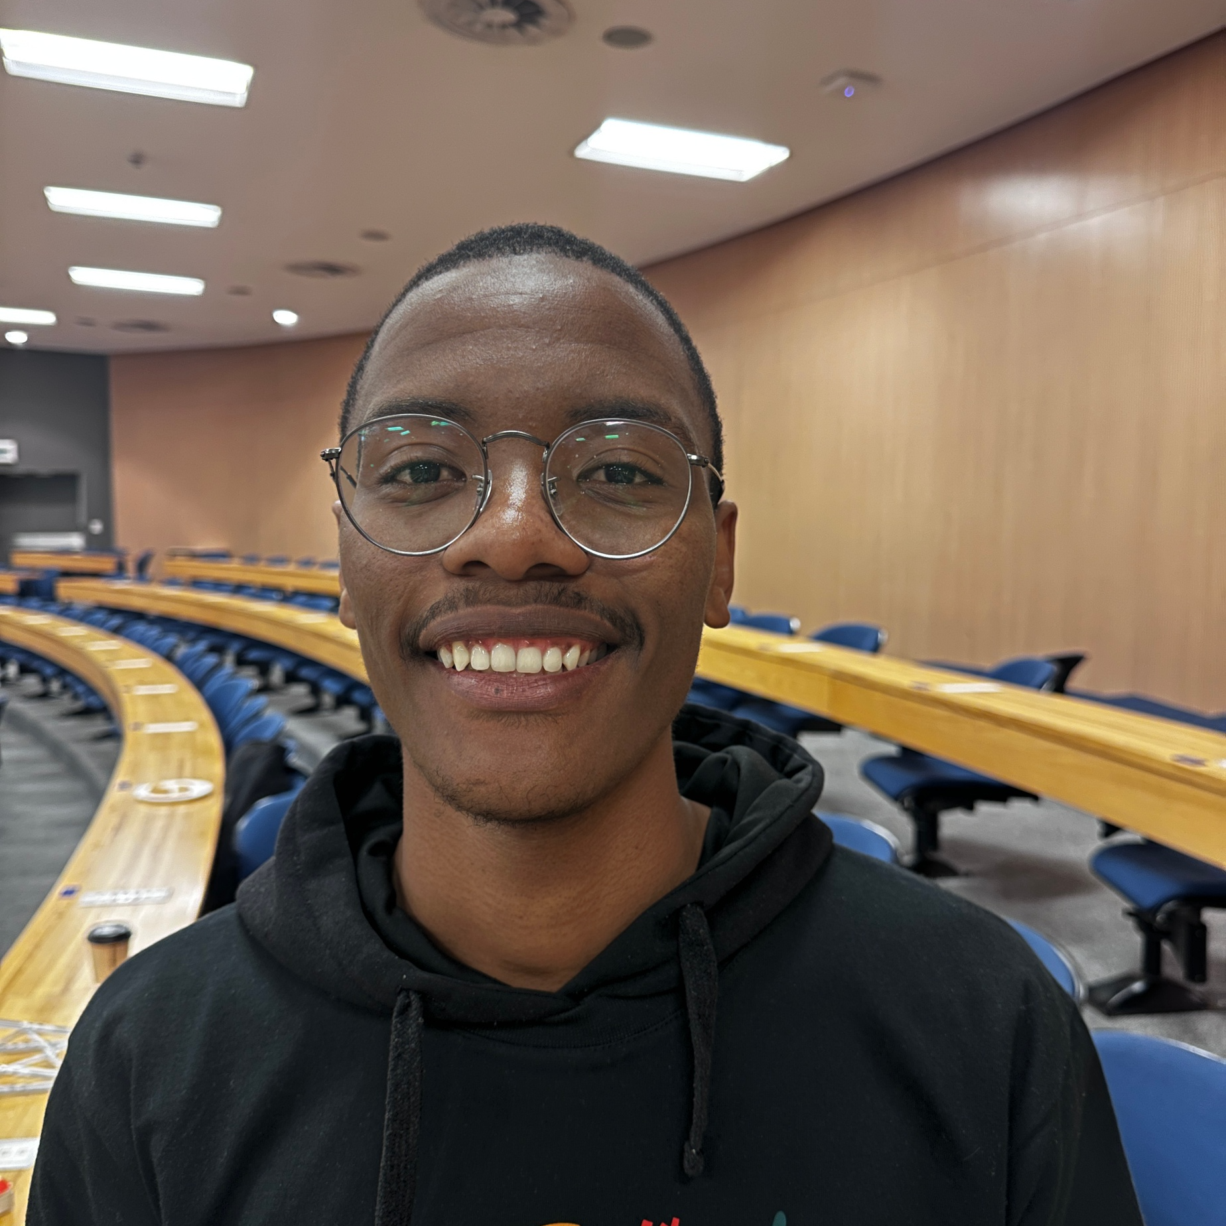



Team and Traction
Siphiwe Bogatsu
Darryl Nyamayaro
Donel Chihoma
Jason Joannou
Co-Founder
Co-Founder
Co-Founder
Co-Founder

Slide 8
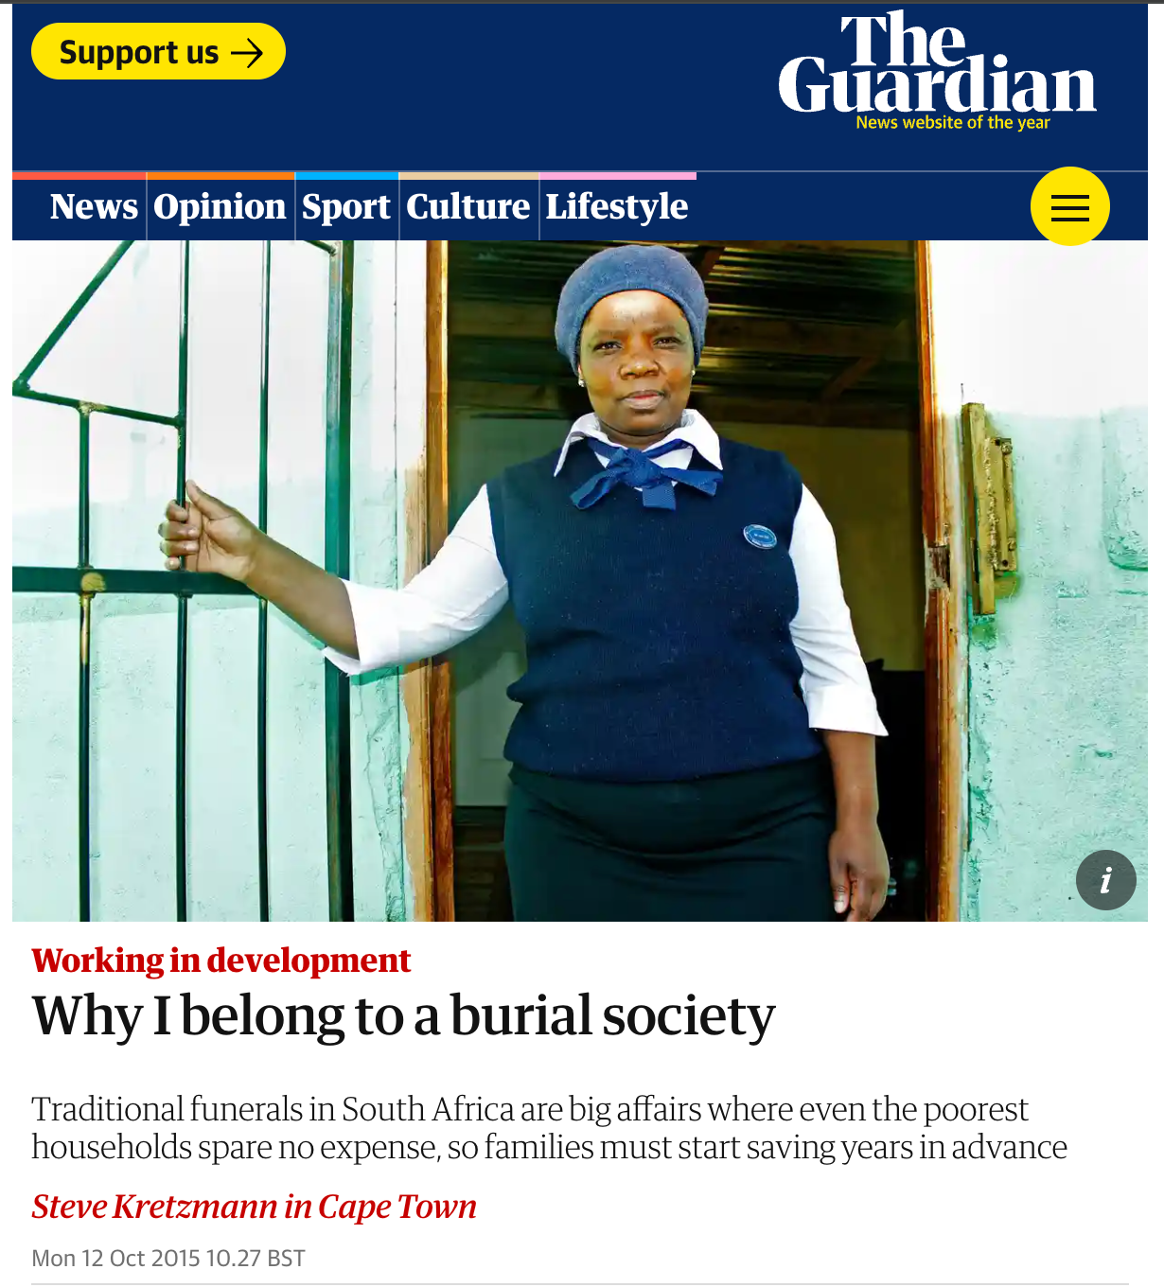
"We are poor in life; Let’s not be poor in death."

